Slide 1
Iowa District West – LCMS
Circuit Convocations – 2014
Congregational Leadership Transition
Preparing Congregational Leadership for Ministry with Christ

Slide 2
Goal
To begin discussion within congregations towards the transition of leaders for ministry into the 21st century

Slide 3
Congregational Leadership Transition
What is Leadership Transition in the LCMS parish?
The dynamics, preparation and implementation of a congregation’s transition of leadership from one generation to the next for the purpose of preparing the saints for continued service to Christ and the Church.

Slide 4
Congregational Leadership Transition Dynamics
Leadership transition is difficult when
  current leaders fail to prepare new leaders or relinquish control.
  current leaders resigns from responsibility without preparing new leaders to step in.
  current leaders are “burnt out.”
  New leaders are unwilling to accept their responsibilities
  “Churchmanship” is not taught and practiced among church leaders

Slide 5
Congregational Leadership Transition Dynamics
When current leaders fail to prepare new leaders or to relinquish control
  continuity of service to members, non-members and community is interrupted.
When current leadership steps down without preparing new leaders to step in, or when current leadership is burnt out and/or new leaders are unwilling
  the congregation suffers from lack of leadership that can lead to low morale and feelings of isolation, inadequacy or being overwhelmed among new leaders and the congregational members.

Slide 6
Congregational Leadership Transition Preparation
Leadership preparation should include theological and practical aspects before responsibility is transferred.

Slide 7
Congregational Leadership Transition Preparation
The theological aspect of preparation includes Scriptural and doctrinal understanding.
Scriptural
  Moses to Joshua; Elijah to Elisha; Saul & David, Qualifications for deacons; to name a few
Doctrinal
  Augsburg Confession; Small Catechism; Prayer; to name a few

Slide 8
Congregational Leadership Transition Preparation; Scriptural
Then ﻿Moses summoned Joshua and said to him in the sight of all Israel, ﻿“Be strong and courageous, for you shall go with this people into the land that the Lord has sworn to their fathers to give them, and you shall put them in possession of it. It is the Lord ﻿who goes before you. He will be with you; ﻿he will not leave you or forsake you. ﻿Do not fear or be dismayed” (Deuteronomy 31:7-8).

Slide 9
Congregational Leadership Transition Preparation; Scriptural
Now when ﻿the sons of the prophets who were at Jericho saw him opposite them, they said, “The spirit of Elijah rests on Elisha.” And they came to meet him and bowed to the ground before him (2 Kings 2:15).
And David came to Saul ﻿and entered his service. And Saul loved him greatly, and he became his armor-bearer. ²² And Saul sent to Jesse, saying, “Let David remain in my service, for he has found favor in my sight” (1 Samuel 16:21-22).

Slide 10
Congregational Leadership Transition Preparation; Scriptural
Deacons likewise must be dignified, not double-tongued, ﻿not addicted to much wine, ﻿not greedy for dishonest gain. ⁹ They must ﻿hold the mystery of the faith with ﻿a clear conscience. ¹⁰ And ﻿let them also be tested first; then let them serve as deacons if they prove themselves blameless (1 Timothy 3:8-10).

Slide 11
Congregational Leadership Transition Preparation; doctrinal
(The one, holy Christian Church) is the assembly of all believers among whom the gospel is purely preached and the holy sacraments are administered according to the gospel. (AC VII; Kolb/Wengert)
Our churches teach that ceremonies ought to be observed that may be observed without sin. Also, ceremonies and other practices that are profitable for tranquility and good order in the church ought to be observed. Yet, the people are taught that consciences are not to be burdened as though observing such things was necessary for salvation [Colossians 2:16-17] (AC XV).

Slide 12
Congregational Leadership Transition Preparation; doctrinal
Teach them first of all these parts: The Ten Commandments, The Lord’s Prayer, The Creed, and so on, according to the text, word for word, so that they too, can repeat it in the same way after you and commit it to memory (SC, Preface; 10).
Rejoice always, ¹⁷ ﻿pray without ceasing, ¹⁸ ﻿give thanks in all circumstances; for this is the will of God in Christ Jesus for you (1 Thessalonians 5:16-18).

Slide 13
Congregational Leadership Transition Preparation; Practical
Some changes may be necessary
Schedules to accommodate new leaders may require changing from past norms.
New leaders may need to be made aware of time constraints, adherence to agendas, how to properly conduct a meeting, etc.
Sharing of responsibilities and authority may help to facilitate continuity.
Newly documenting responsibilities by position can help clarify how things get done.
Ministry in today’s world pushes leaders to be creative as they think “outside the box.”

Slide 14
Congregational Leadership Transition
Goals of Leadership Transition
  Assist the Pastor in equipping the saints for mission and ministry.
  Lay leaders actively sharing the Gospel in ministry with Jesus every day.
  Recognizing that the Church is “one body with many members” (1 Corinthians 12). All gifts are worthy and useful.
  Continuity of service to others in conjunction with the maintenance and use of congregational assets.
  That all things be done decently and in order (I Corinthians 14:40)

Slide 15
Congregational Leadership Transition
Challenges
  One size does not fit all. Specifics of leadership transition depend on both current and future leaders working together for the benefit of the kingdom.
  Affluent and struggling congregations all face a world that is fallen and darkened by sin, death and the devil.

Slide 16
Congregational Leadership Transition
Challenges
  Generational leaders (current or new) can be their own worst enemy
  Overactive families
  Resistance to change when change is necessary
  The need to get new people involved
  The resistance to new people getting involved
  Budgets, attendance, attrition, fear for the future
  Outdated Constitution & By-Laws
  Accomplishing a gradual and consistent handing off of leadership responsibilities
  Develop trust between generations recognizing the distinctions within generational models

Slide 17
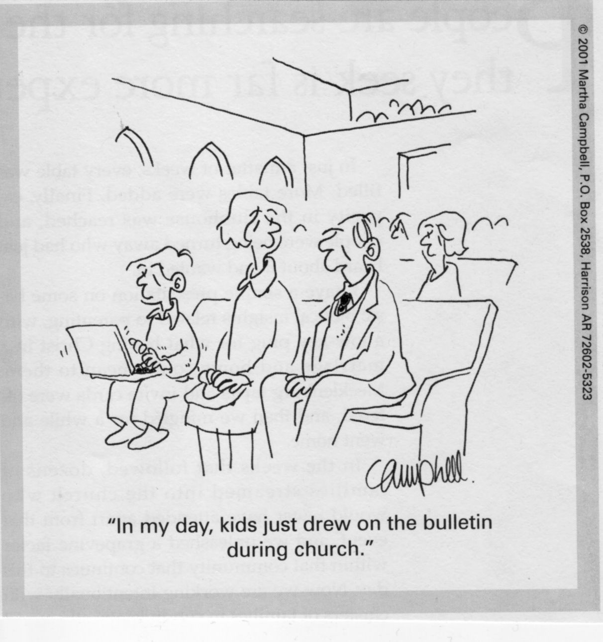
One Church Four Generations

Slide 18
Generational Diversity
Youth (0-25) Generation X Postmoderns | Young Adults (26-44) Generation Next Busters | Midlife (45-64) Builders | Elderly (65-over) Matures Traditionalists
Millenials | MTV Generation |  | GI Generation
Echo Boomers |  |  | Seniors
Gamers Generation Z |  |  | Veterans Post War
Internet Generation |  |  | Silent Generation
Bridgers |  |  | Lost Generation The Greatest Generation
Generation Y | Generation X | Boomers | Builders

Slide 19
Generation Y ages 0-25
General Characteristics
  Socially connected
  Environmentally conscious
  Economically concerned
  Are accustomed to instant gratification
  Want to experience Life
  A Spiritual Generation
Leadership Characteristics
  More than twice the size of Generation X, so will move into management positions more quickly.
  Optimists
  Healthy sense of community

Slide 20
Generation X ages 26-44
Generation Characteristics
  Witnessed the beginning of the technology boom
  Were the first to embrace the personal computer
  Most impacted by the current recession
  Spiritual Seekers
Leadership Characteristics
  Are cynical of politics and corporate America
  Good problem solvers
  Healthy sense of vocation
  Personal involvement in ministry

Slide 21
Boomer Generation ages
45-64
General Characteristics
  Hard working
  The Me Generation
  Want to contribute to their society
  Commitment to Christ is personal
Leadership Characteristics
  Have a strong desire to advance their careers
  Value, Vision, and Purpose driven
  They are a generation on a mission
  They are looking for a church with a mission

Slide 22
Builder Generation ages 65+
Leadership Characteristics
  Loyal to leaders and trusting of the “chain of command”
  Fiscally prudent with a strong work ethic
  Support “their” Church
  Self-disciplined
  Stability

Slide 23
Builder Generation ages 65+
General Characteristics
  GI Generation
    WWII veterans
    Great Depression
    Builder because they rebuilt the country
  Silent Generation
    Benefited the most financially from the post war boom
    Technological progressive
    Conformity and cooperation
  In Church every Sunday
  Spirituality is centered on public worship and private prayer

Slide 24
Congregational Leadership Transition
Implementation
  Keep the mission of seeking and saving the lost primary
  Maintain Word and Sacrament ministry
  Learn and continue to be the Hands and Feet of Jesus in the world
  Intentionally grooming new leaders and giving recognition for the value of current leaders
  Develop intergenerational leader through process of mentoring

Slide 25
Congregational Leadership Transition
Tasks To Consider
  Evaluate current Constitution and By-Laws; rewrite changeable sections as necessary with regard to current practice and procedure; submit any changes to IDW for approval
  Address scheduling issues with flexibility
  Contrast responsibilities with current structure with regard to the various ministry areas, including but not limited to Human Care, Evangelism, Stewardship, Elders and Discipleship, Trustees, Education, Youth and Councils
  Develop guidelines for healthy Conflict Resolution
  Develop policies for weddings, confirmation, funerals, building usage, sex offender registry attendees , and the like

Slide 26
Prescription for a
Healthy Transfer of Leadership
Addressing Fear and Building Trust
Seeing Generationally
Prioritizing Values
Clarifying Vision

Slide 27
Addressing Fear
Too much change
Too little change
Four intergenerational fears
  Not being accepted
  Must always do things the same
  Not doing things good enough
  Being silenced

Slide 28
Building Trust
Communication between the generations
Bring people together—planned intergenerational events—joint activities
Let leaders do their job without worrying about how it was done in the past
Identify and mentor young leaders

Slide 29
Seeing Generationally
Modern
  Knowledge is certain
  Knowledge is objective
  Knowing is better than not knowing
Postmodern
  Knowledge is helpful but not necessary
  In place of objective truth there is simply my individual perspective
  Knowledge always comes with prejudices, with beliefs, with a background

Slide 30
A Tool for Discerning Core Values
Values - what are we about?
  Personal Values
  Congregational Values
  Generational Values
    Generation Y
    Generation X
    Boomers
    Builders

Slide 31
Listing of Value Statements
What are our core values?
How might these be perceived by the differing generations?
Ordering - what’s most important – What are our Core Values?

Slide 32
Congregational Leadership Transition
Q & A

Slide 33
Subject: Member Talents
How well does your congregation follow the 1 Corinthians 12 principle of a variety of gifts for the building up of the church?
What is one way your congregation implements this principle? What could be done better?
Are there certain members who seem to unofficially “run the church”?
How is your congregation perceived in your community? Do negative comments and messages from members make their way among other members and into the community?
Is social media helpful or hurtful as it pertains to your congregation?

Slide 34
Subject: Constitution & Bylaws
Have you read your congregation’s Constitution & Bylaws? When were they written and/or revised last?
Do your bylaws serve your congregation adequately?
Do you agree with the statement: “Your Constitution & Bylaws should serve the congregation and not the congregation serves the Constitution & Bylaws?”

Slide 35
Subject: Pastor/Congregation Relationship
Can Elders/Council/Voters tell their pastor how to conduct the worship service or other things he must do? Can a pastor dictate to his congregation what they must do? By what authority are these decisions made?
What should be the role of the pastor in the process of transitioning leaders within the congregation?

Slide 36
Subject: Communication
How is the Eighth Commandment practiced in your congregation?
What does the “unofficial meeting” in the church parking lot sound like? What is being said? Is it helpful or hurtful? What statements do members make about your congregation?

Slide 37
Subject: Conflict Resolution
Are there any unresolved conflicts or underlying issues within your congregation?
What is the procedure for resolving conflict in your congregation? Do you need a conflict resolution procedure policy or trained committee for dealing with conflict?
What happens when members go outside healthy conflict resolution procedures?

Slide 38
Prepared by:
Rev. Ray Smith
Rev. Dr. Steve Turner
Rev. Roger Carlisle
Mr. Jason Fuller

